Slide 1

Advanced Bitcoin Market Price Forecasting Using Machine Learning Techniques
Presented by:
S.Tejaswi (21MQ1A4226)
V.Dilip Datta Sai (21MQ1A4256)
Md.Neelofar(21MQ1A4220)
R.Kapil Harsha(21MQ1A4252)
HEAD OF THE DEPARTMENT: Dr . SYAM PRASAD,
B.Tech, M.Tech, PHD
Under the Guidance of:
M . Naresh Babu,
Assistant Professor

Slide 2
CONTENTS
ABSTRACT
EXISTING SYSTEM
PROPOSED SYSTEM
HARDWARE REQUIREMENTS
SOFTWARE REQUIREMENTS
ANALYSIS
DESIGN
KEY FEATURES
APPLICATIONS

Slide 3
ABSTRACT
This project focuses on developing an advanced forecasting system for Bitcoin market price prediction using XG Boost . The system aims to capture complex price trends, volatility, and market sentiment. It leverages historical price data, trading volume, macroeconomic indicators, and social media sentiment analysis to enhance prediction accuracy. The goal is to assist traders, investors, and financial analysts in making data-driven decisions, reducing risks, and optimizing investment strategies in the highly volatile cryptocurrency market.

Slide 4
EXISTING SYSTEM
Traditional statistical models :
ARIMA (Autoregressive Integrated Moving Average)
GARCH (Generalized Autoregressive Conditional Heteroskedasticity)
Challenges:
Limited ability to handle non-linearity, market volatility and low performance delivered.
Inefficient in capturing complex dependencies.

Slide 5
PRORPOSED SYSTEM
Machine learning-based approach: The proposed system uses XG Boost, an advanced gradient boosting algorithm that enhances the accuracy and efficiency of Bitcoin price prediction. XG Boost handles large datasets efficiently, captures non-linear relationships, and provides feature importance insights. The model is trained on historical Bitcoin price data and market sentiment to generate highly accurate forecasts while preventing overfitting using regularization techniques.

Slide 6
Software Requirements
Programming Languages: Python, R
Libraries & Frameworks: TensorFlow, PyTorch.
Scikit-learn for machine learning.
Pandas, NumPy, SciPy for data preprocessing.
XGBoost for predictive modeling.
APIs & Data Sources: Binance API, Coin Gecko API for market data.
Twitter API, Google Trends for sentiment analysis.
Cloud Computing: AWS, Google Cloud, or Azure for model deployment.

Slide 7
Hardware Requirements
Processor: Intel Core i5/i7 (or equivalent AMD Ryzen)
RAM: Minimum 16GB (Preferred: 32GB for large datasets)
Storage: SSD (Minimum 256GB, Recommended: 512GB+)
GPU: NVIDIA RTX 2060 or higher for machine learning models.

Slide 8
ANALYSIS
The dataset contains Bitcoin price data, including Open, High, Low, Close, Volume, and Market Cap. Data cleaning involves converting non-numeric fields, handling missing values, and ensuring consistency. Algorithms mainly consists of XG Boost for handling non-linear data. Trend analysis identifies historical price movements and volatility patterns, while feature correlation explores relationships between trading volume, sentiment, and price fluctuations. Moving averages and volatility assessments help evaluate short-term and long-term market trends, providing insights into potential price shifts.

Slide 9
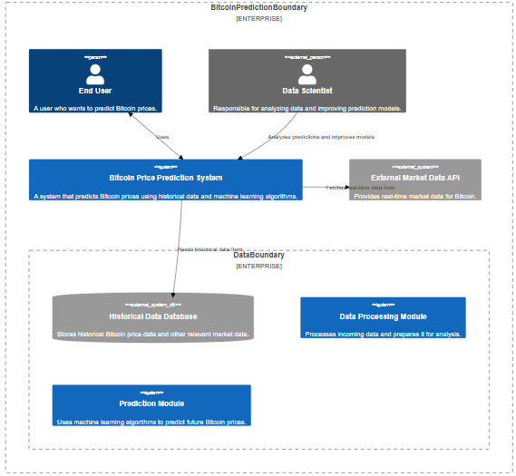
SYSTEM ARCHITECTURE DIAGRAM

Slide 10
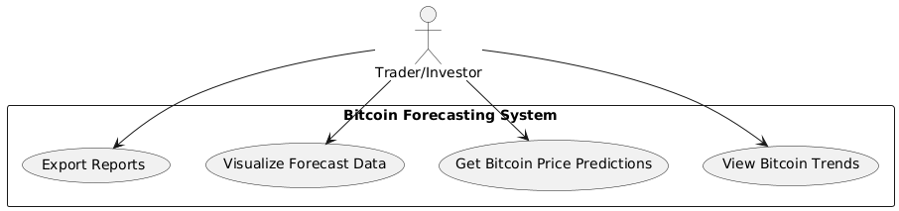
USE CASE DIAGRAM

Slide 11
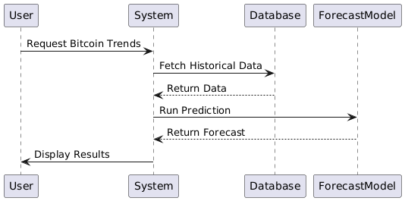
SEQUENCE DIAGRAM

Slide 12
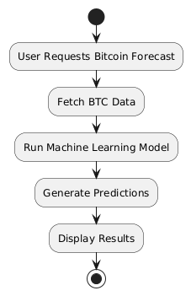
ACTIVITY DIAGRAM

Slide 13
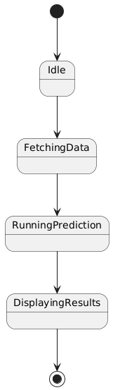
STATE CHART DIAGRAM

Slide 14
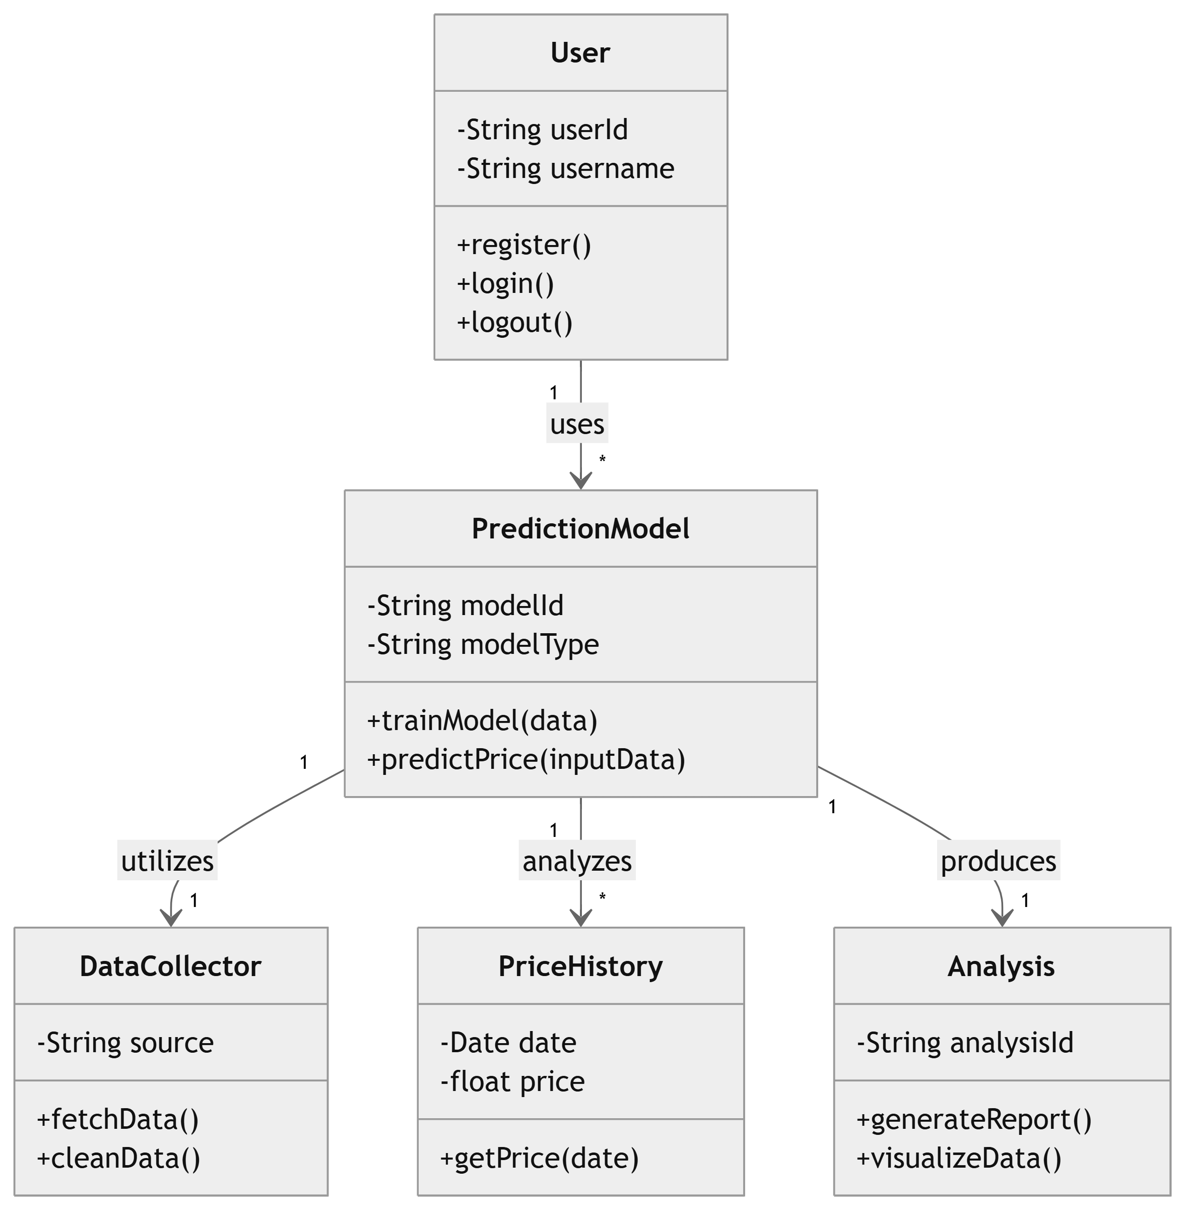
CLASS DIAGRAM

Slide 15
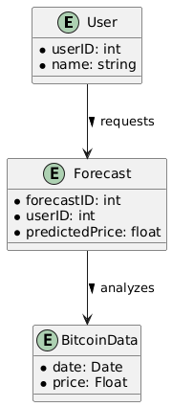
ENTITY-RELATIONSHIP DIAGRAM

Slide 16
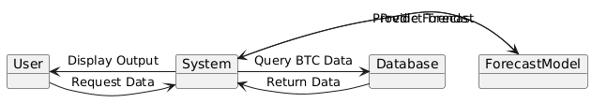
COLLABORATION DIAGRAM
Run model
Predict Forecast

Slide 17
APPLICATIONS
Cryptocurrency trading and investment decision support.
Financial market analysis for hedge funds and portfolio managers.
Risk management and portfolio optimization.
Blockchain and crypto exchange optimization.
Academic research and fintech innovations.

Slide 18


